Slide 1
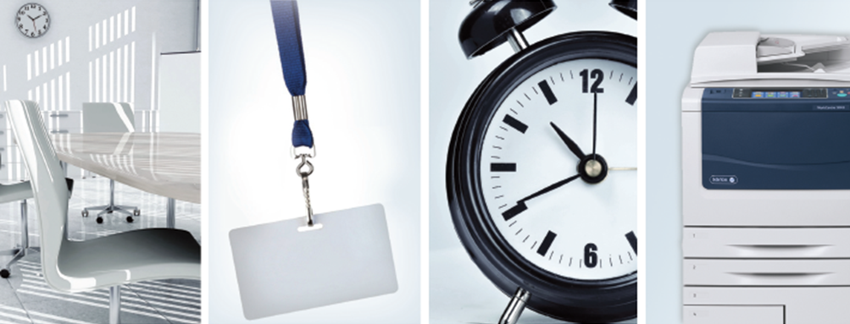

Slide 2
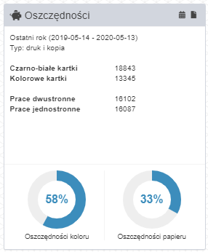
Printing cost ?
Experts estimate that 80-90 % users don't know what the printing costs are. Meanwhile, they may constitute up to 3 - 4 % the company's income.
We can change this thanks to DocuProfessional.
Our system ensures compliance with print safety requirements and full control of printing costs.

Slide 3
Secure Print
Companies in which employees print, scan, copy and e-mail hundreds of important documents every day are exposed to data leakage.
Potential risk areas:
unsecured access to the device control panel
documents left on the feeder
unsecured access to functions: copying, scanning
unsecured print
printing private documents at work
data leak
DocuProfessional offers complete security in this area!

Slide 4
Work ergonomics
Have you had a situation where the printer is busy and you wait for other employees to collect their printout from the device?
Have you ever had a situation where your printed work was taken by another employee or put away and incomplete?
Have you ever had a situation where you could not print, scan or copy due to a damaged device?
If any of the answers is YES, it's a sign that it's time to implement a central printing system DocuProfessional.

Slide 5
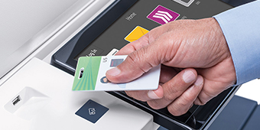
What is a system DocuProfessional ?
DocuProfessional is an integrated solution for managing print, copy and scan on multifunction devices Xerox, Epson, HP, Brother.
The system allows monitor costs, and provides an effective way to control and manage the company's print environment.

Slide 6
Main features of DocuProfessional?
centralized cost accounting for printing, copying and scanning
central management of devices in branches
authorization with a proximity card; PIN code or login data from AD
confidential and follow-up printout
system integration with the multifunction device panel
defining the print policy (creating rules: printing, copying, scanning)
device status monitoring - toner and paper levels, failures, errors *
central administration panel accessible via the web interface
job management: active, favorite, history, delete
scanning on e-mail and to the logged-in user's folder
* selected functions available for given manufacturers and device models

Slide 7
Basic modules DocuProfessional

Slide 8
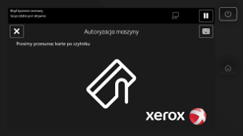
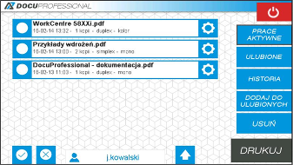
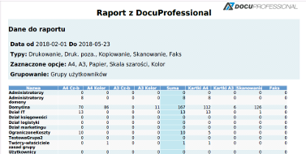
Basic modules DocuProfessional
Assec to the devices is secured. The user can unlock
the device using his own access card or PIN code / login and password AD.
Receiving print from any devices* connected to the system (follow-me printing). The necessity of authorization guarantees the confidentiality of printing.
It enables obtaining detailed quantitative and cost reports containing data on printouts, scans and copied documents.
* list of devices available in the presentation

Slide 9
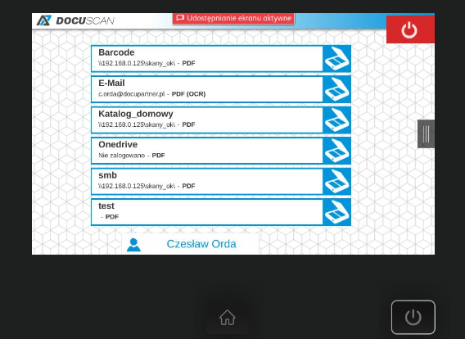
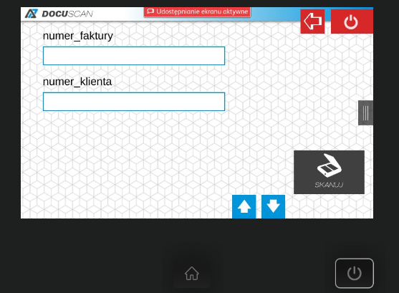
Basic modules DocuProfessional
DocuScan - parameterized scan functions for a shared user resource, network resource or his e-mail.
Scan templates created in the central DocuProfessional system are available on devices connected to the system for shared user groups.

Slide 10
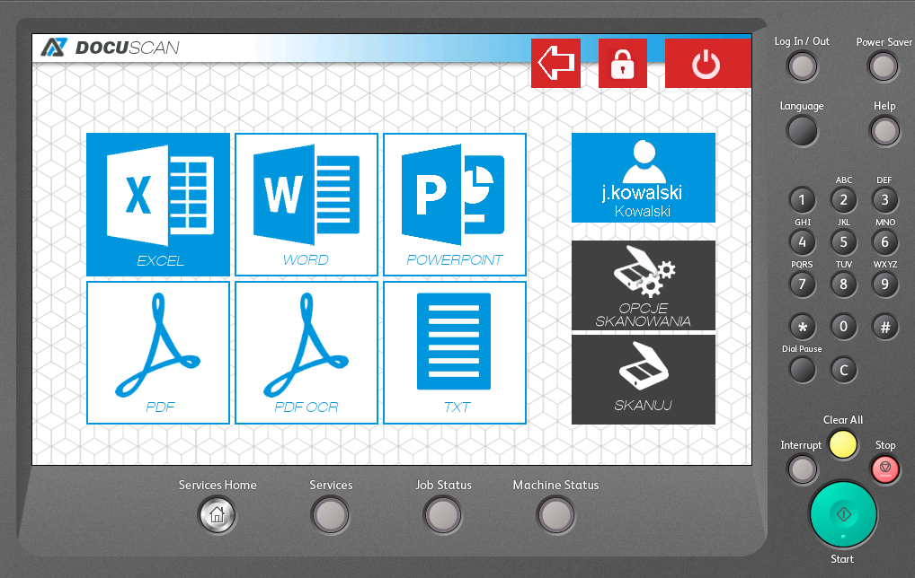
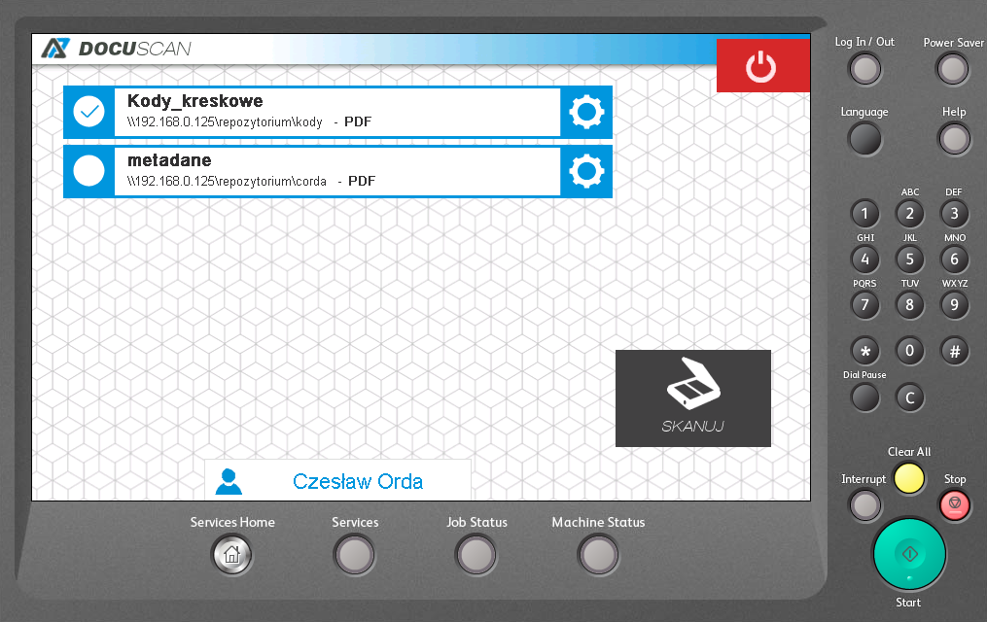
Additional modules DocuProfessional
DocuOffice – scan to editable formats, incl. Word, Excel, PowerPoint, ... and sending work to e-mail or to the logged in user's network folder.
DocuBarcode – scanning documents with barcode recognition. Barcode as page separator and saved to the file name.

Slide 11
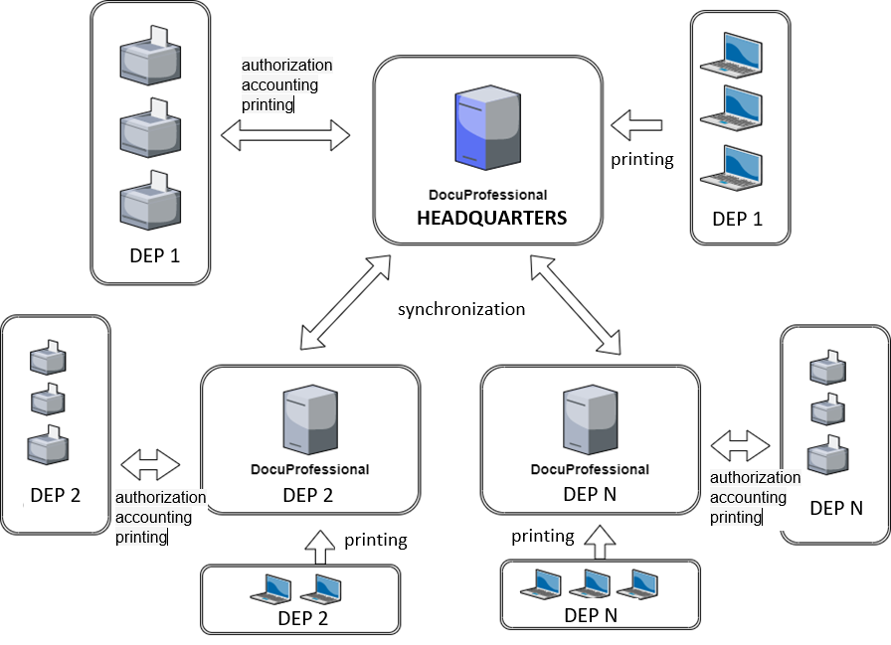
Architecture: Headquarters + Departments

Slide 12
FUNCTIONALITY
Licensing:
licensing of individual system modules
separate licensing for printers and multifunction devices
no license restrictions as to the number of system users
licensing for the number of devices connected to the system
licensing for a specific period of time
no license restrictions for connecting any number of branches
Access control:
possibility of securing user access to multifunction devices
possibility of blocking all functions of the device and unblocking them after authorization
the ability to print all works while logging in
possibility of user authorization using an electronic card using an external authorization reader or alternative logging in with a PIN code or login and password from AD
possibility of automatic assigning of proximity cards by users using PUK codes (automatic generation by e-mail or first printout) or using AD user data
the ability to download a list of users from external data sources such as: Active Directory, csv file
possibility to create several different connections to AD
automatic synchronization of users with LDAP
support for printouts from various systems, including: Windows, Linux, iOS
cooperation with the EFI Fiery print server *
Polish or English user interface on the device panel

Slide 13
FUNCTIONALITY
Follow Printing:
functionality of following and secured printouts
the ability to receive the created task on any compatible device connected to the system
possibility of picking up the created task in any branch
the ability to manage the job queue from the MFP display of the device
possibility of canceling works, reprinting from history
the ability to change job settings before printing on the device: number of copies, duplex printing, color / mono mode
the ability to preview the work before printing
the ability to release all or selected jobs from the print queue
the system displays only the work of the currently logged in user on the device
possibility of reprinting jobs without printing ("Favorites")
printout of documents from folders, printout via email, printout via file upload
direct print
advanced management of the printing process (print queues)
notifications on the device about the job status of printed documents
counting works in real time
the system has the function of distinguishing between monochrome and color pages in mixed works, i.e. those that contain both mono and color pages
the ability to generate PIN and PUK codes by users (via an account on the website)
printout of files sent to E-Mail, upload of files by the user's website (mobile printout)
the possibility of delegating work to any person / persons

Slide 14
FUNCTIONALITY
Reporting:
central reporting system (settlement of each branch from the position of the central system)
possibility of generating a time report separately for: printing, copying, scanning, fax
the ability to generate a report separately in the following formats: A3, A4, color, mono
the ability to group reports into: units, users, devices, user groups, device groups
the ability to generate a quantitative and cost report
the ability to generate a report for projects (printing, copying, scanning)
the ability to generate automatic reports and send them via e-mail to selected people
Monitoring *:
monitoring of the status of consumables
monitoring the level of paper trays (every 25% for selected models of devices)
current reading of device counters; service error report from devices
automatic notifications: counters, materials, out of paper, service events
defining notifications for multiple levels of consumable status
Scanning:
central scanning system
the ability to manage scans by defining scan templates from the system level for groups
possibility of counting and reporting scanned works
the ability to scan to a defined user directory; e-mail of the logged in user
the ability to assign templates for selected user groups
the ability to define the path and file name from dynamic variables, e.g. user login, group, home folder
scan to OneDrive

Slide 15
FUNCTIONALITY
scanning with m input parameters and saving them to the file name
scanning with forcing the provision of the necessary parameters (e.g. invoice number, selecting data from the dictionary, etc.)
scanning with a document division every n pages for the pdf format
scanning to multiple e-mail addresses
Rules*:
the ability to apply rules to print, copy and scan tasks
possibility of notifications about the application of a rule, forcing double-sided printing, b / w printing
the ability to limit printing, copying, scanning for individual users, groups, devices
possibility to set quantity and cost rules for works: printed, copied, scanned
the ability to define a rule due to the file name, extension
the ability to define access rules for printing, copying, scanning at specific times
the applied rules work in the headquarters as well as in each branch
Administration:
central management system accessible via a web browser
central management system for all departments, all devices
central system for adding devices, users and groups
administration panel interface in Polish and English
configuration of SMPT, LDAP e-mail settings
management of users, devices, groups of users and devices
rule management; authorization history on the device
the ability to configure the number of preview pages on the device
the ability to define the time for how long active jobs are to be stored in history
the ability to set that all print jobs and stored on the server are encrypted
the possibility of assigning aliases to the user, which allow the identification of the same user with different logins from systems
setting how long printed and active jobs are to be stored on the server

Slide 16
FUNCTIONALITY
DocuOffice, DocuBarcode (add-on modules):
scanning with text recognition, processing of documents to file formats such as: doc, xls, ppt, PDF, searchable PDF, txt / csv
the ability to open files in programs such as: Word, Excel, PowerPoint, AdobeReader
sending processed documents by e-mail as a link to an attachment or a logged-in user's folder
scanning documents from the panel of the multifunction device with the text recognition function,
hotfolder - processing pdf files to the selected format (input directory of documents to be processed and output directory with processed documents)
hotfolder codes - processing pdf files with barcodes from the selected folder and saving the code name to the file name and sending the result to the appropriate directory
defining multiple scan templates for specific groups of users
configuration of the system view (access to selected formats; scanning options) on the device panel for user groups
scanning with barcode recognition (barcode as a document distribution; code as file name)
defining access rights to selected templates for user groups
the ability to send documents to the selected email and document to the appropriate format
scanning with a document division every n pages for the pdf format
scanning with a split document every n pages for ocr
* not all functions are available on certain device models. Details at the Docu-Partner software manufacturer.

Slide 17
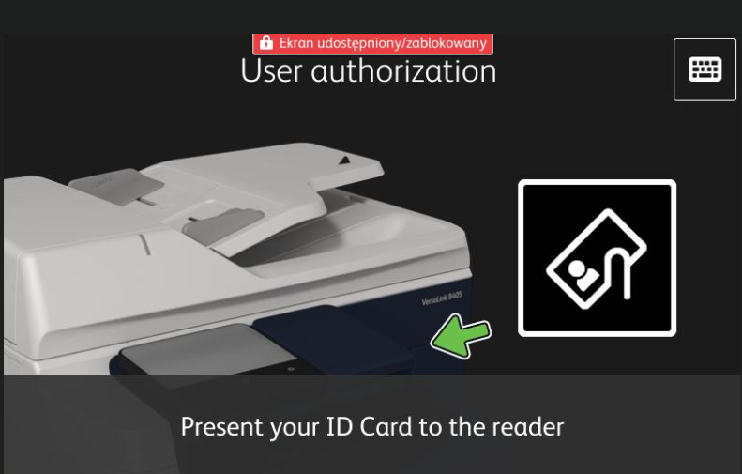
Authorization - card reader
Unlock the Xerox device with an access card (such as one it uses for room access, for example). There is an alternative login: with a PIN code or logging in from AD (to a computer).

Slide 18
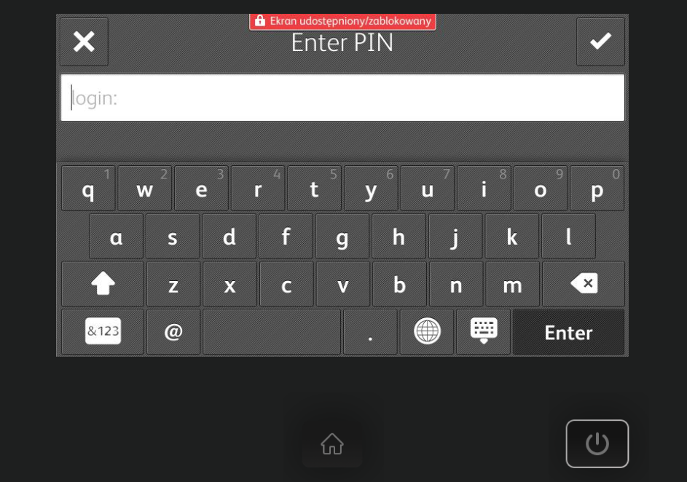
Authorization - PIN
Alternative login: with an individual user PIN code

Slide 19
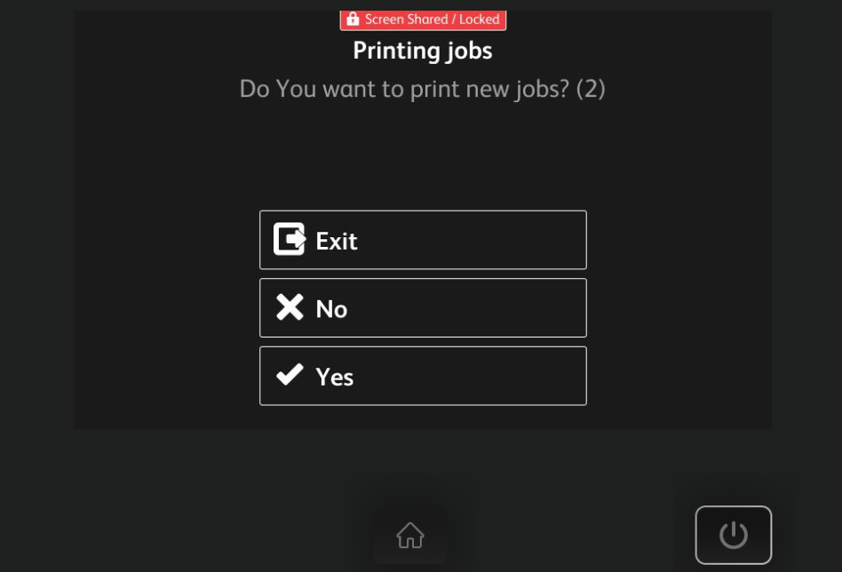
Printing
Yes - the possibility of printing immediately after logging in, unblocking the device
No - resignation from printing, unblocking the device.

Slide 20
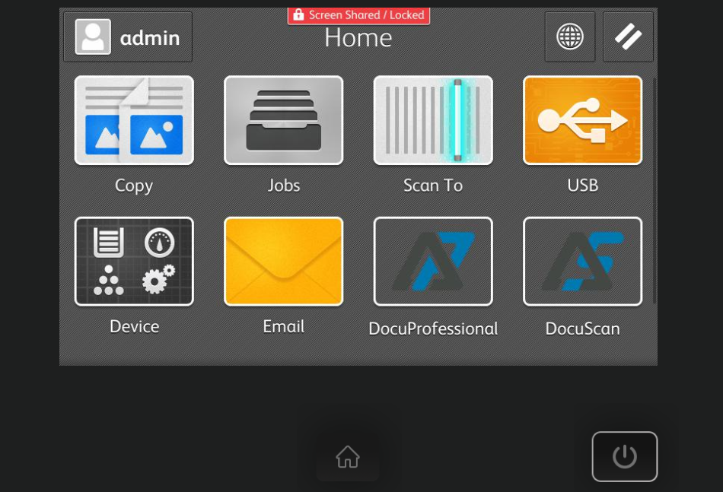
Printing - DocuProfessional
Device unlocked per user.
All activities: printing, copying, scanning are monitored and counted for a given logged in user.

Slide 21
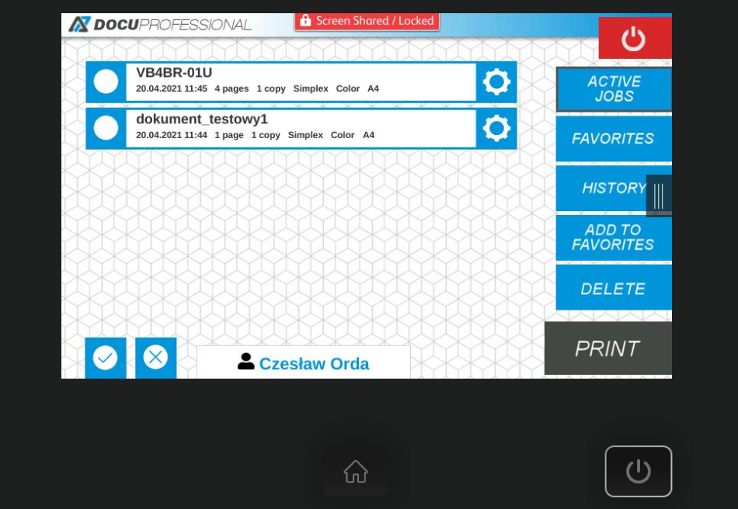
Application DocuProfessional, Printing - active jobs
The user can manage his print queue: active jobs
Possibility to print, remove, transfer to favorite selected works

Slide 22
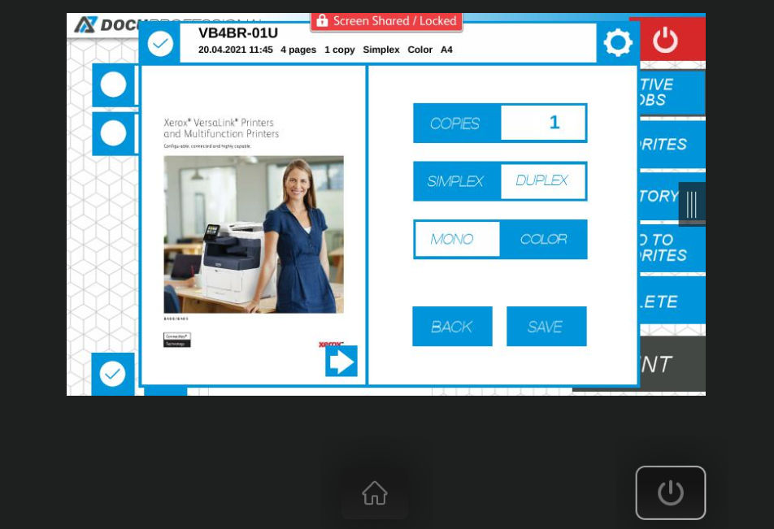
Printing - work preview, parameters change
The ability to preview the work before printing and change the basic parameters of work on the device.

Slide 23
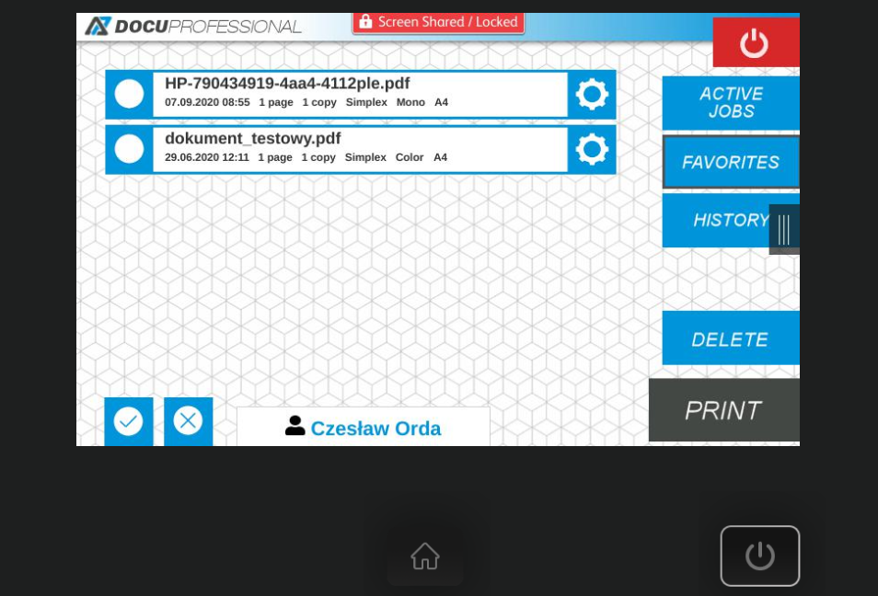
Printing - Favorite
The user can manage his works and add to favorites (works that he wants to have "on hand" to be printed on the selected device)

Slide 24
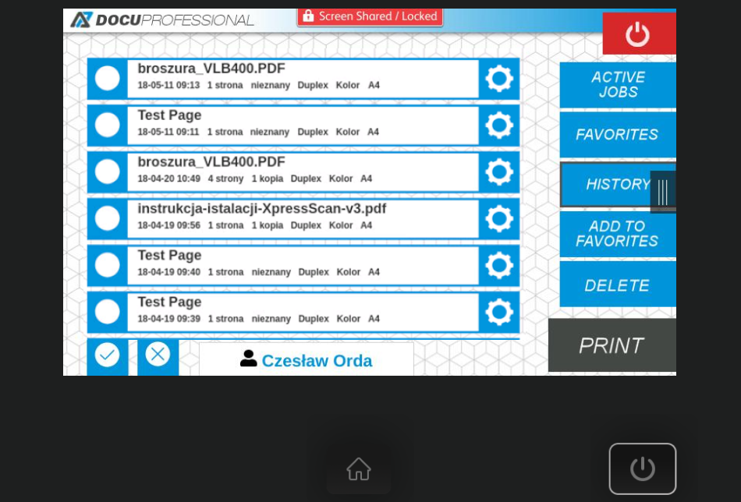
Printing - history
The user has access to his history of printed works (possibility of reprinting and previewing works)

Slide 25
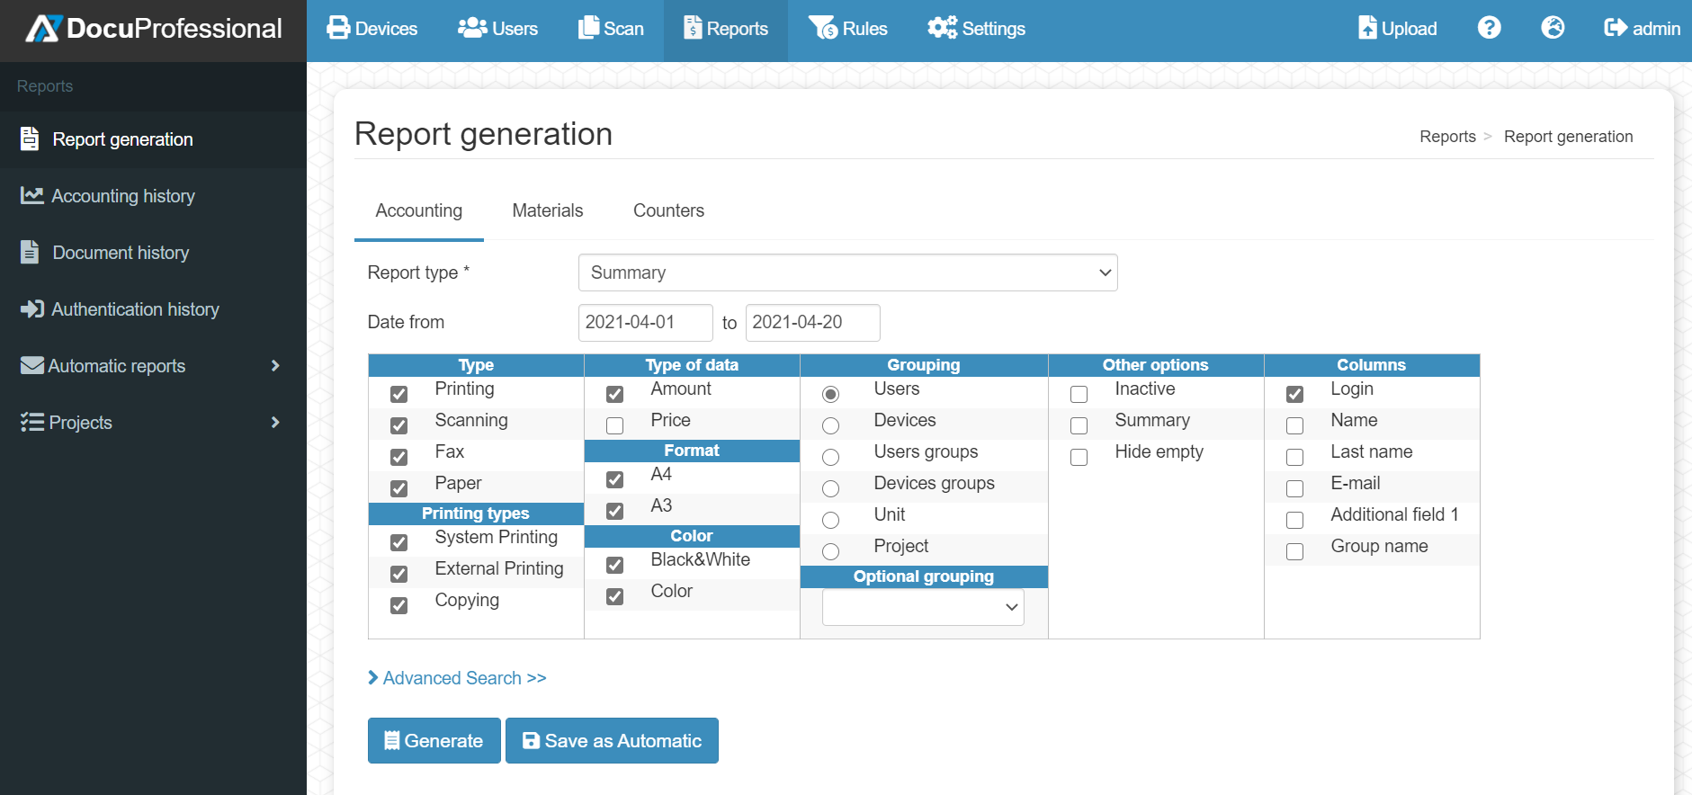
Reporting

Slide 26
Reporting: quantitative and cost-effective
Quantitative report for user groups:
Quantity and cost report for users:

Slide 27
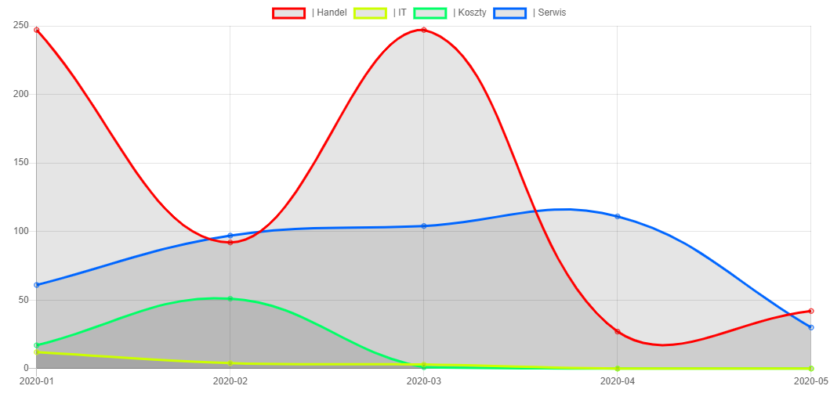
Reporting: charts
User report
Report over time for departments

Slide 28
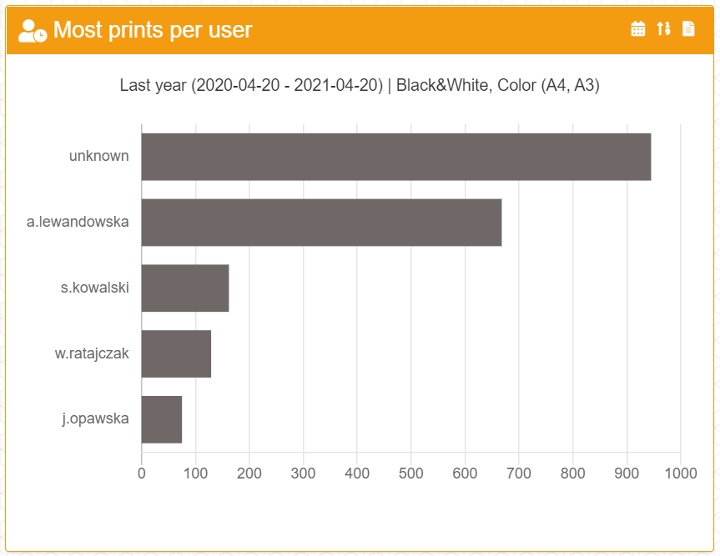
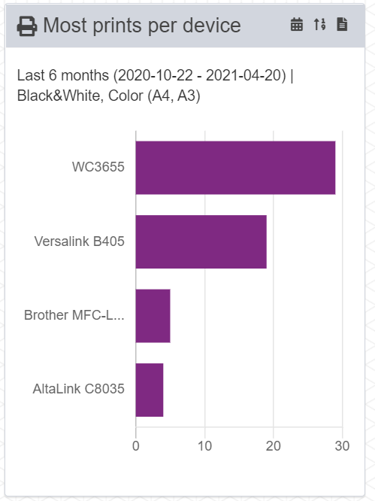
Reporting dashboard: charts
Dashboard report: most prints per users, devices

Slide 29
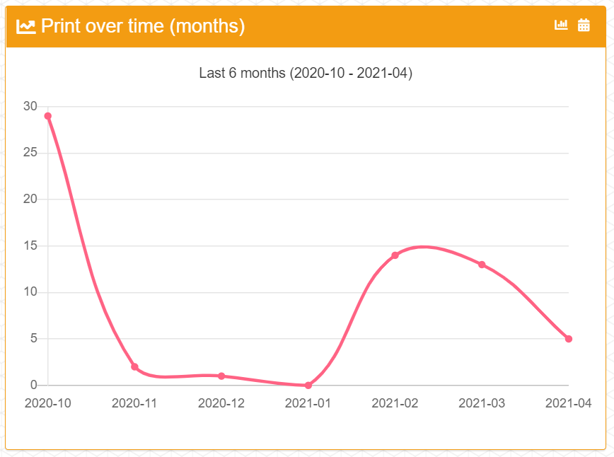
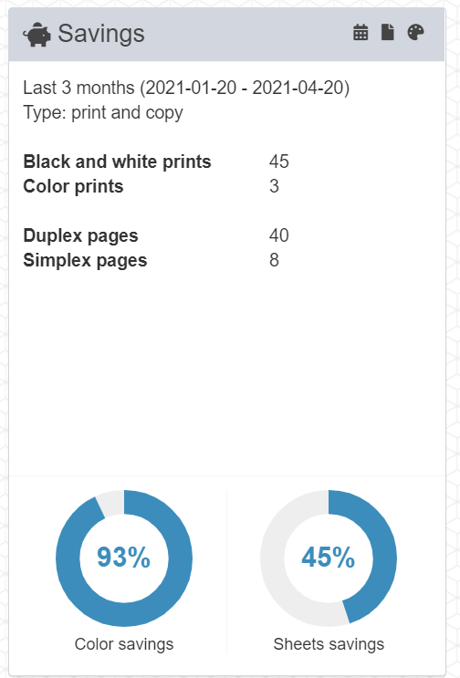
Reporting dashboard: charts
Dashboard report: printouts over time: months, savings report
Raport dashboard: oszczędności, mój raport

Slide 30
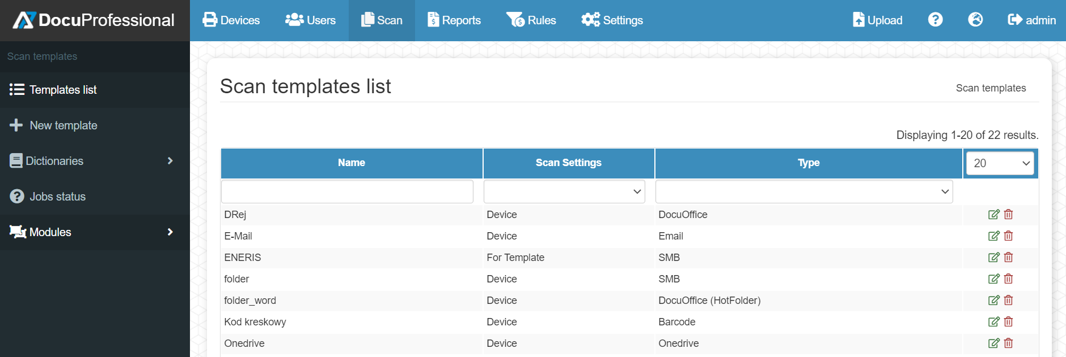
Scanning - DocuScan
Szablony skanowania
Status of scanned jobs

Slide 31
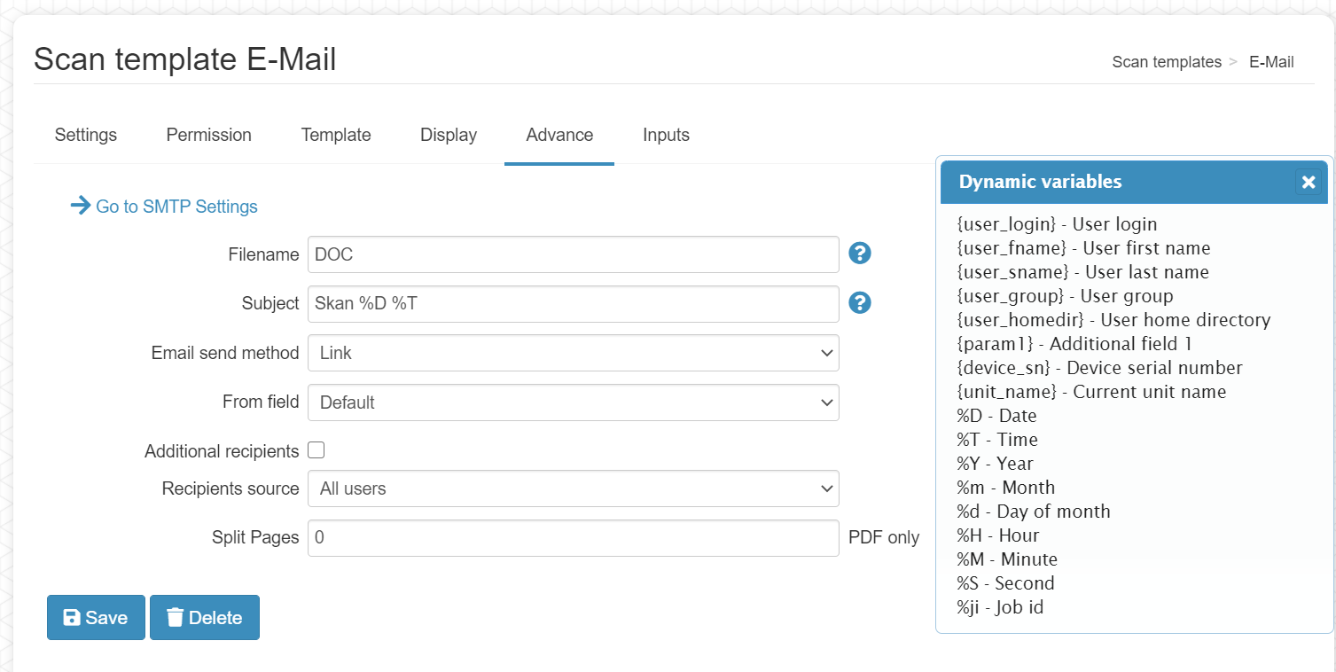
Scanning - DocuScan

Slide 32
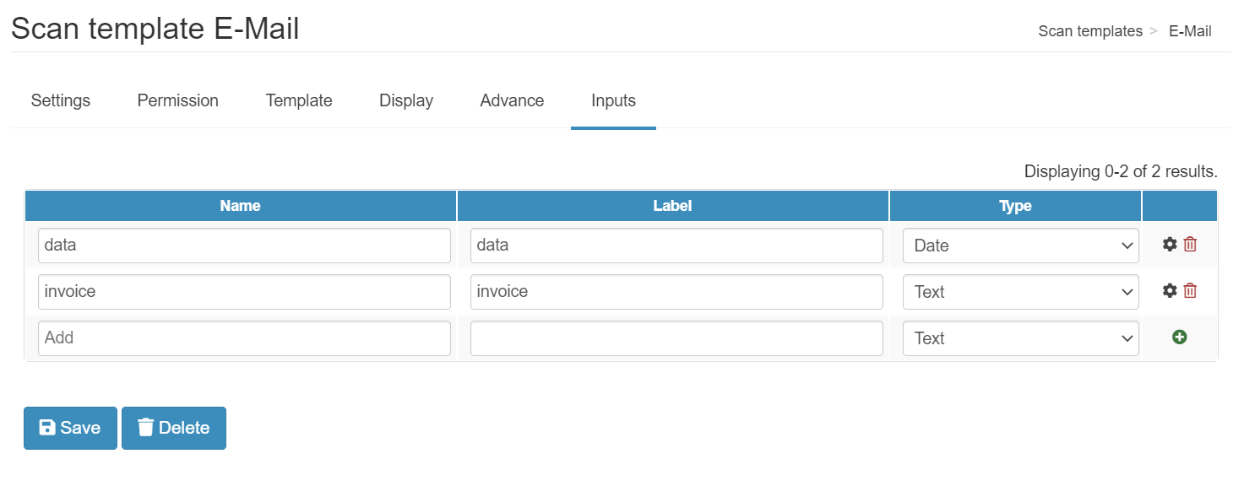
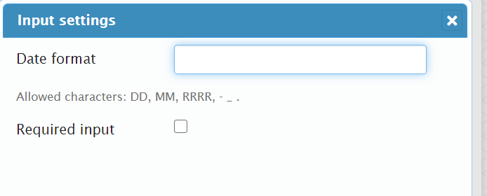
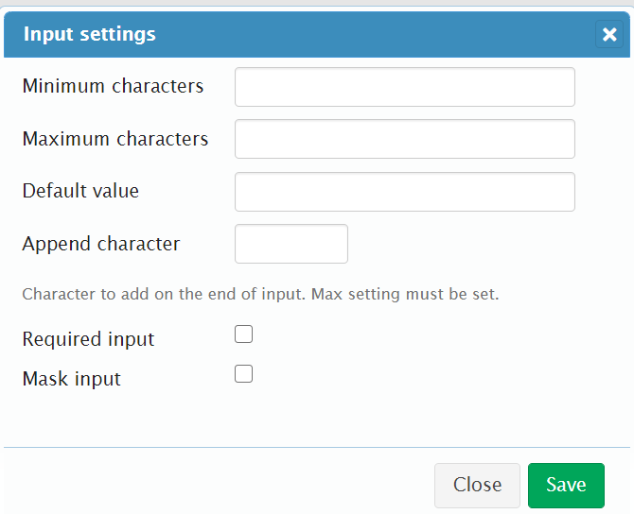
Scanning - DocuScan

Slide 33
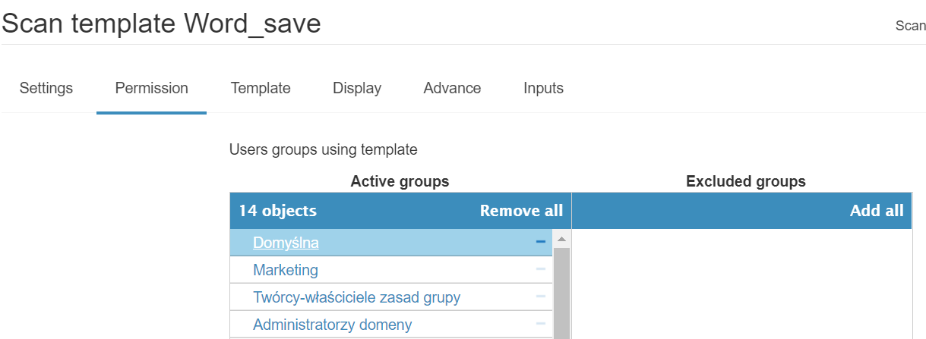
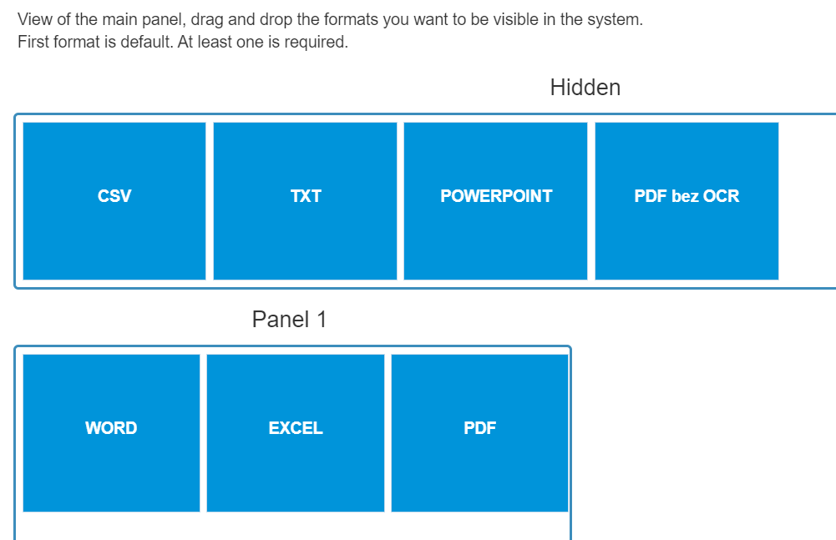
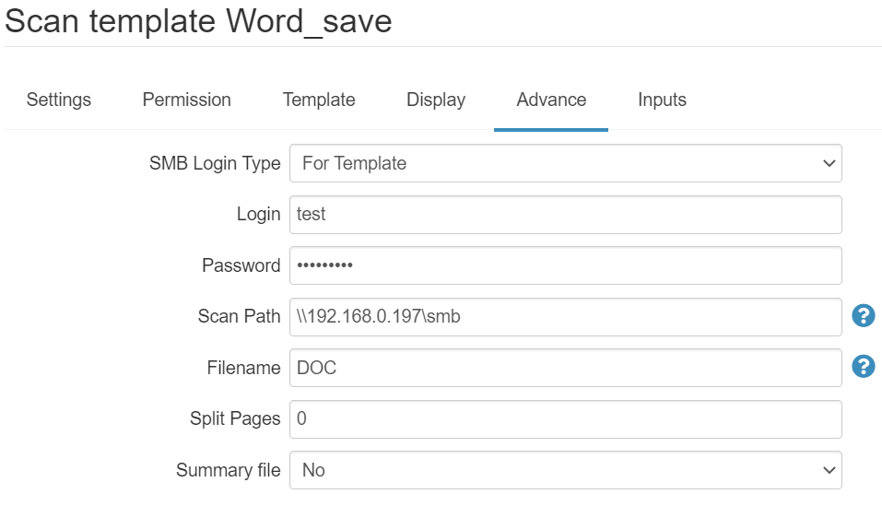
DocuOffice – scanning to Word, Excel, PoweProint, ….

Slide 34
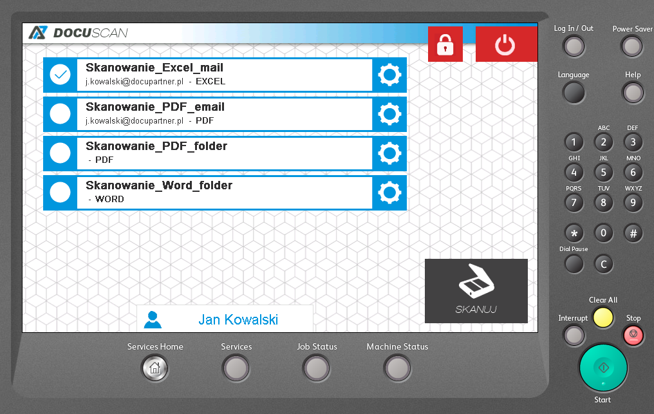
OCR module - save to Word, Excel, ...
simple scanning with conversion
to the selected format: Word, Excel,
PowerPoint, PDF, PDF OCR, TXT
sending the result to the e-mail or folder
logged user
configuration of permissions and views
for user groups

Slide 35
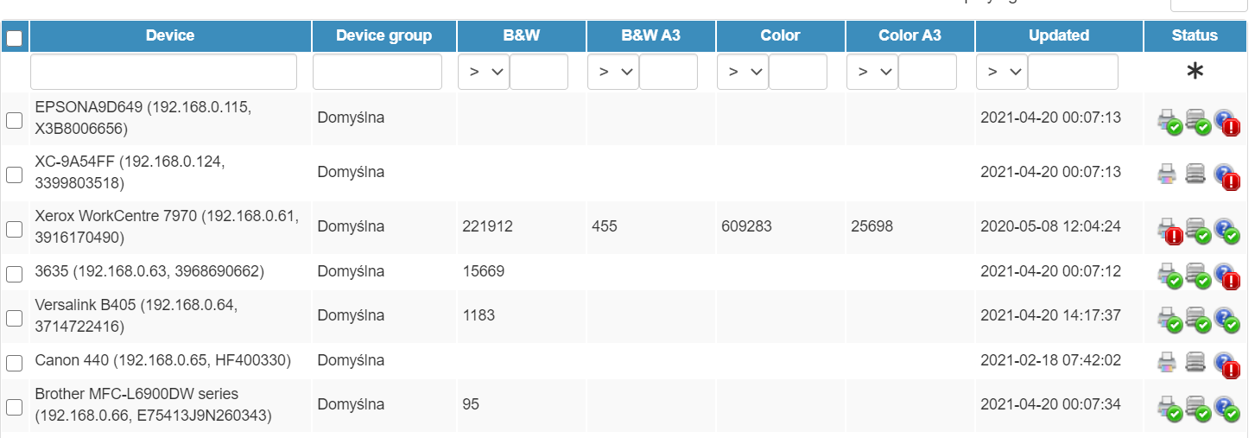
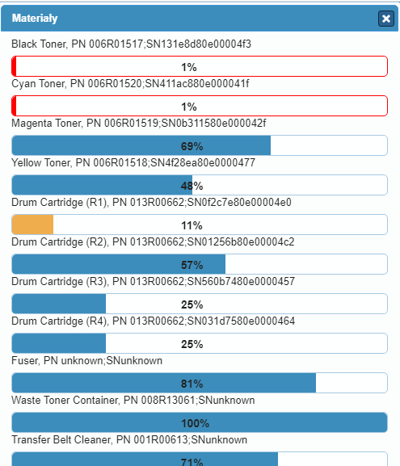
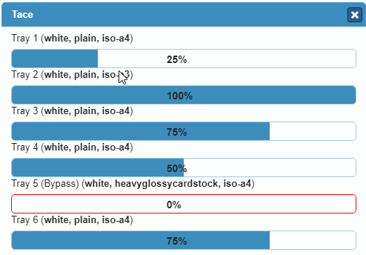
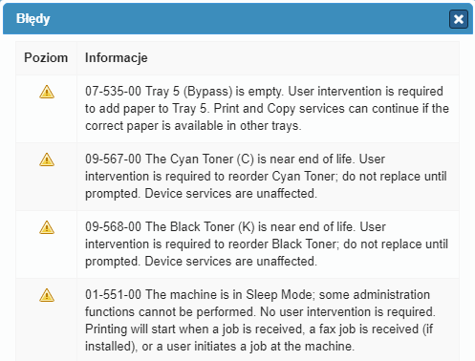
Device monitoring

Slide 36
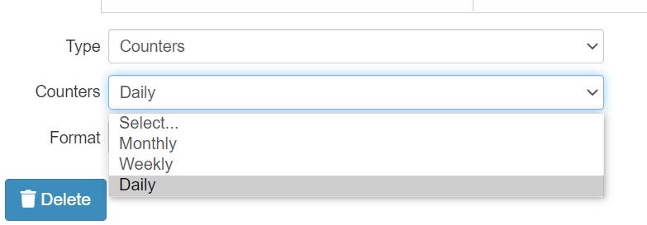
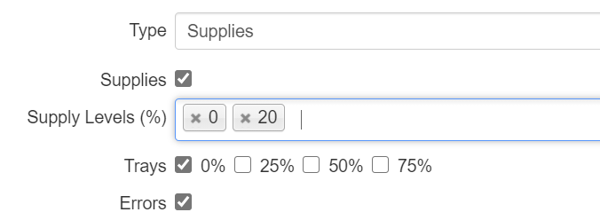
Device status - automatic notification

Slide 37
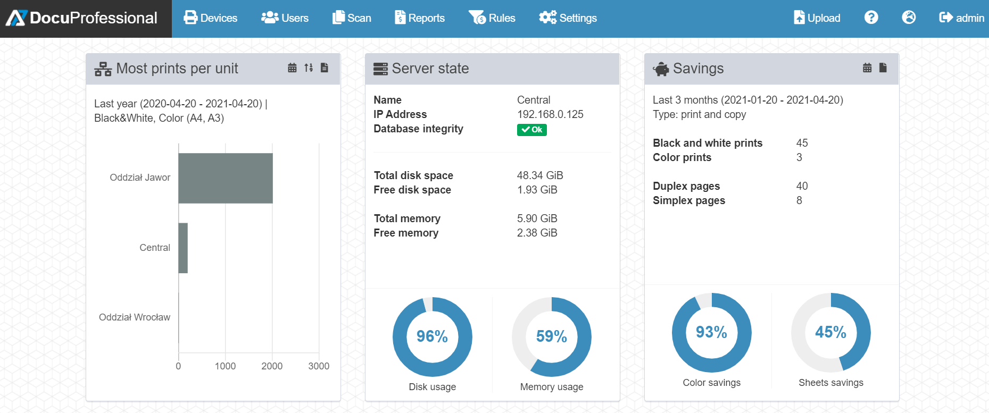
Administrator panel - dashboard

Slide 38
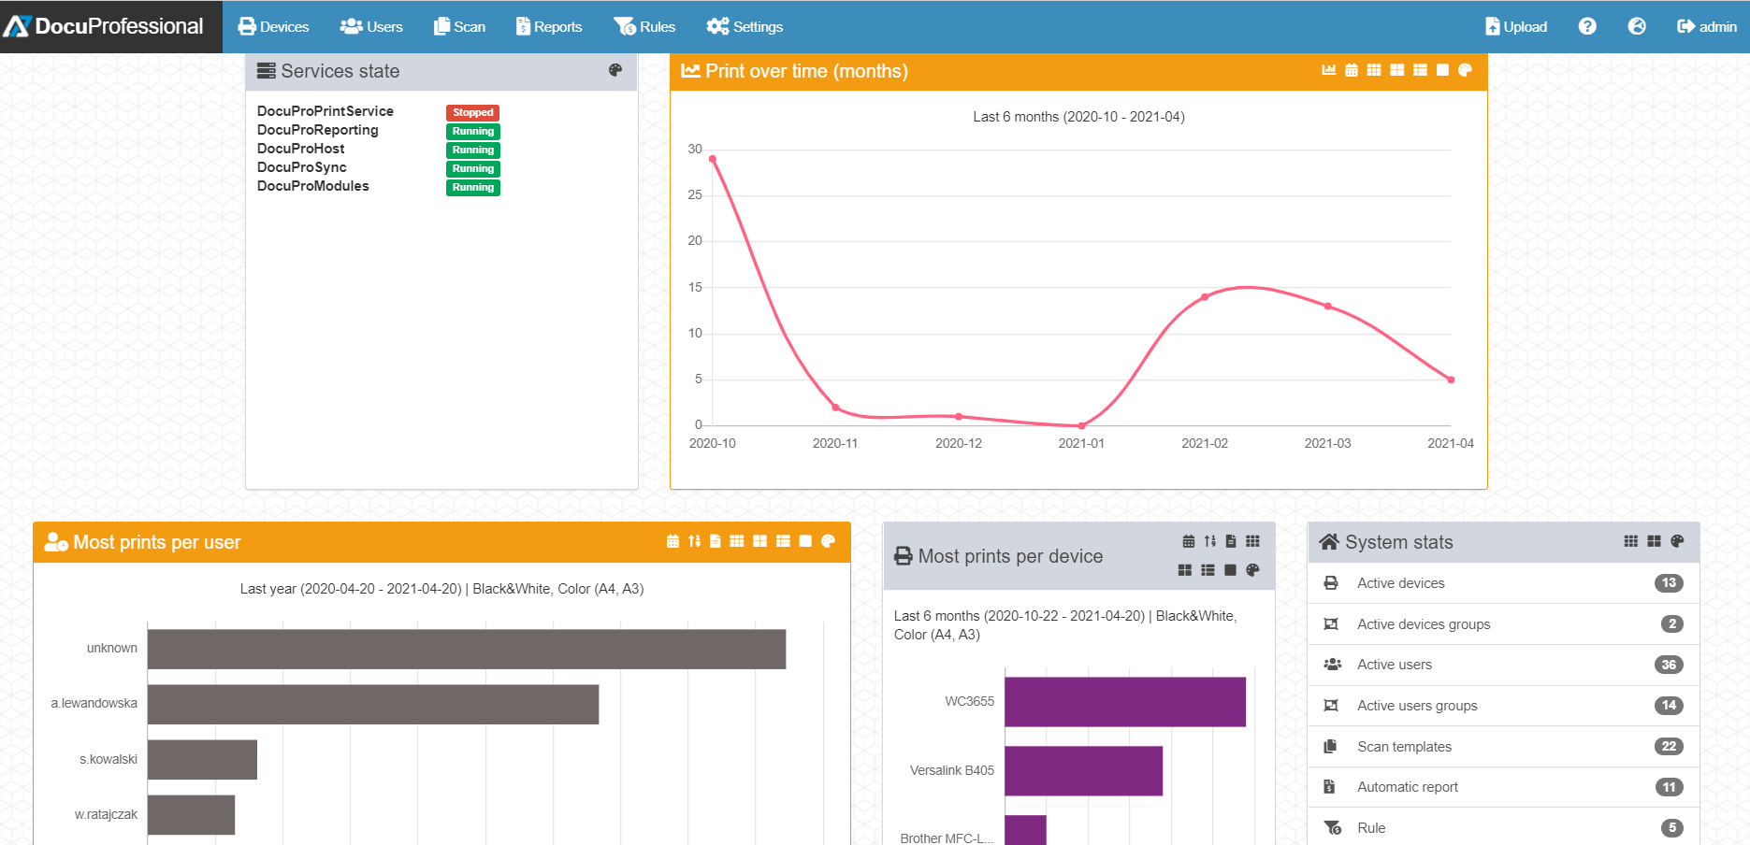
Administrator panel - dashboard

Slide 39
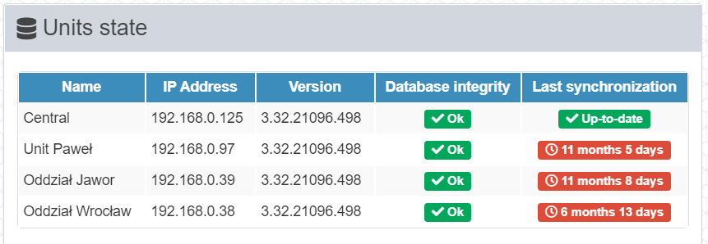
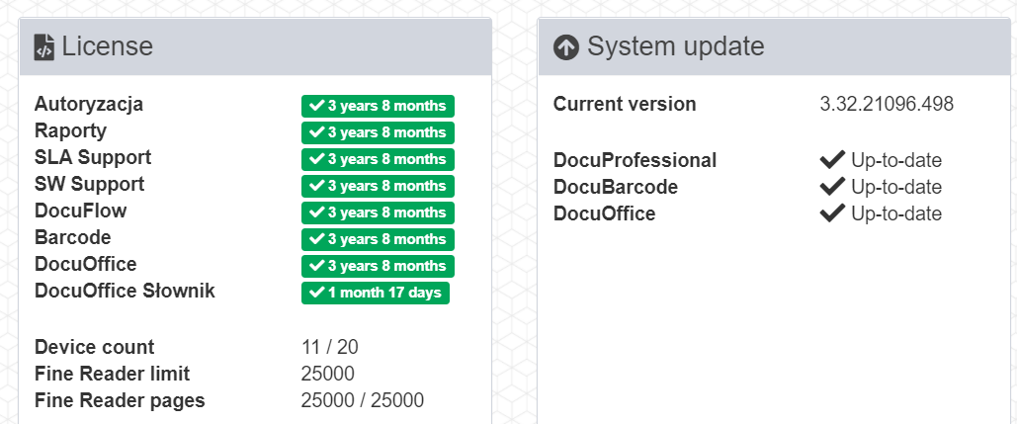
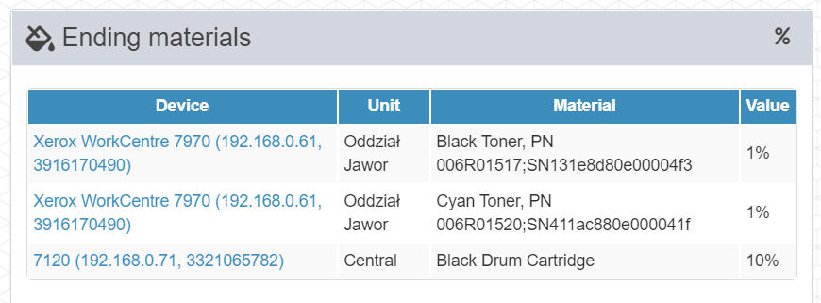
Administrator panel - dashboard

Slide 40
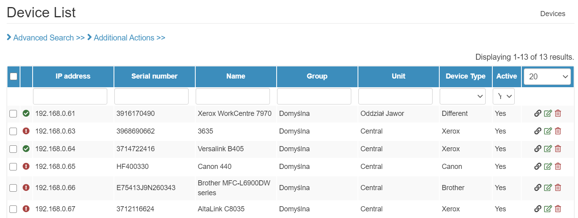
Administrator panel - devices

Slide 41
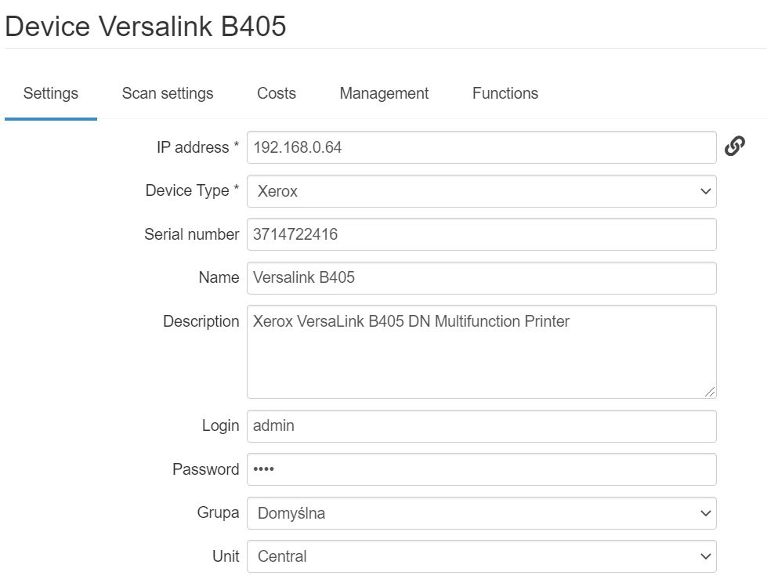
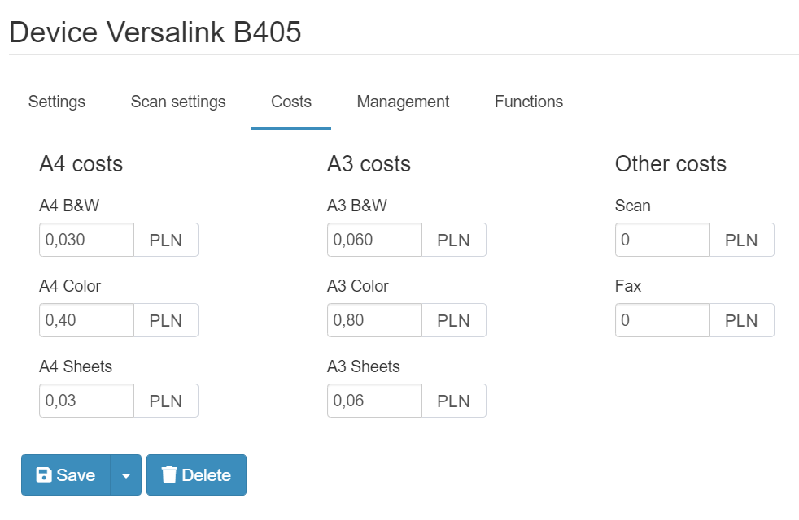
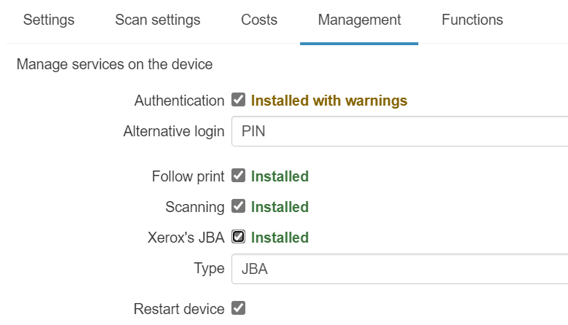
Administrator panel - devices

Slide 42
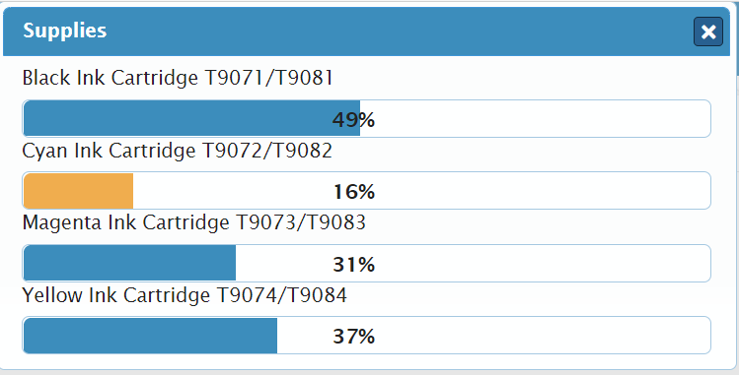
Administrator panel – devices status

Slide 43
Administrator panel – users

Slide 44
Administrator panel – users

Slide 45
Administrator panel – rules

Slide 46
Administrator panel – settings

Slide 47
Xerox supported models
Xerox A4:
Xerox Phaser 3635MFP S/X
Xerox WC 3655, WC 6655
Xerox Versalink: B400, C400, B405
Xerox Versalink: C405,C505, B605
Xerox A3:
Xerox WorkCentre 53xx, 57xx, 58xx, 59xx
Xerox WorkCentre 7120/25, 7220/25, 73xx
Xerox WorkCentre 75xx, 76xx, 77xx, 78/79xx
Xerox Color 550/560, 4112/4127
Xerox Versalink B70XX/C70XX
Xerox Altalink B80XX / C80XX
Xerox Altalink B81XX / C81XX

Slide 48
Epson supported models
Epson A4:
WF-5690; WF-M5690;WF-R5690
WF-6590; WF-C5790;WF-5799;
WF-579R
Epson A3:
WF-C878R; WF-C879R;WF-8590;
WF-R8590; WF-C869R
PX-M7050FP/FX; PX-M7070FX;
WF-C20590; WF-C20600;WF-Enterprise C17590

Slide 49
HP supported models
HP A3 MFP:
LaserJet E72535
LaserJet E72530
LaserJet E72525
Color LaserJet Managed MFP E87660
Color LaserJet Managed MFP E87650
Color LaserJet Managed MFP E87640
Color LaserJet Managed MFP E77830
Color LaserJet Managed MFP E77825
Color LaserJet Managed MFP E77822
HP A4 MFP:
LaserJet Managed E52645
Color LaserJet Managed Flow E57540c
Color LaserJet Managed E57540dn
LasetJet Enterprise Flow MFP M577z
LasetJet Enterprise Flow MFP M577c
LasetJet Enterprise MFP M577f
LasetJet Enterprise MFP M577dn
LaserJet Enterprise M527cm
LaserJet Enterprise M527dnm
LaserJet Enterprise M527c
LaserJet Enterprise M527z
LaserJet Enterprise M527f
LaserJet Enterprise M527dn
LaserJet Managed M527cm
LaserJet Managed M527dnm
LaserJet Enterprise MFP M630 series
LaserJet 500 MFP M575
https://developers.hp.com/oxpd-netjava/doc/compatible-devices

Slide 50
Brother supported models
Brother A4 MFP:
DCP-L5500DN
DCP-L5602DN DCP-L5650DN DCP-L5652DN DCP-L6600DW MFC-8530DN MFC-8535DN MFC-8540DN MFC-L5700DN MFC-L5700DW MFC-L5702DW MFC-L5750DW MFC-L5755DW MFC-L5800DW MFC-L5802DW MFC-L5850DW
Brother A3 MFP:
MFC-J5945DW
MFC-J6947DW
MFC-J6945DW
MFC-L5902DW MFC-L6700DW MFC-L6702DW MFC-L6750DW MFC-L6800DW MFC-L6900DW MFC-L6902DW
DCP-L8410CDW
MFC-L8610CDW
MFC-L8690CDW
MFC-L8900CDW MFC-L9570CDW/T

Slide 51
Licensing DocuProfessional
License for individual modules DocuProfessional * system, 1 device, 5 devices, 10 devices, 50+ devices, 1 year updates
License for DocuProfessional * updates for the next year,
2 years, 3 years, 4 years , 5 years
Full manufacturer service license for DocuProfessional * for 1 year, 2 years, 3 years, 4 years, 5 years
License for the OCR add-on module (saving to Word, Excel ...) DocuOffice, DocuBarcode
* modules: authorization, follow-up printout, reporting, rev

Slide 52
Why DocuProfessional ?
the most important functions of print management systems,
simple installation and configuration,
simple and flexible licensing,
the ability to adapt the system to customer requirements,
direct support for the end customer,
the best price offer on the market

Slide 53
Implementation DocuProfessional
Law firms
Media
Manufacturing plants
Courts
Municipalities
Hospitals
Service companies
Logistics companies
Corporations
Other

Slide 54
Contact

